Slide 1
Tomasulo Algorithm

Slide 2
Dynamic Scheduling: The idea
Simple pipelining techniques:
In-order instruction issue.
In-order execution.
DIV.D F0,F2,F4
ADD.D F10,F0,F8
SUB.D F12,F8,F14
New:
use inorder instruction issue
out-of-order execution

Slide 3
Dynamic –Scheduling using Tomasulo’s Approach.
Hazards = data, structural, control
  Data: RAW (true data dependence), WAR ( anti-dependence), WAW (output dependence)
  Structural: Are the required resources available?
  Control: Is this instruction supposed to execute or not?
Implementation –
Data flow – Tomasulo, IBM 360/91 (1967)
    Simple idea – when opcode and operands are ready, and the appropriate set of resources are ready, launch the “execution packet”
    Interesting wrinkle – does not used named registers for intermediate storage
    Implicit introduction of Register Renaming

Slide 4
Register Renaming
Can eliminate name dependence (and hence WAR and WAW)
Static renaming example:
Original After Renaming R2 to R6
ADD R1, R2, R3 ADD R7, R2, R3
SUB R2, R3, R4 SUB R6, R3, R4
AND R5, R1, R2 AND R5, R1, R6
LD R1, 0(R4) LD R1, 0(R4)
Increase ILP, increases register pressure
Can be done dynamically in hardware

Slide 5
Computing Model
Data
  Ops view sources and destinations as memory
  Hence registers not explicitly named in the ISA stream
Control
  Multiple FU
    Each fronted by one or more “reservation stations” (RS)
    When reservation station has all of the source operands then it issues
  Outputs
    Physically placed on a Common Data Bus (CDB)
    Tagged so the RS know what to look for
  Inputs
    Supplied with instruction or collected by RS

Slide 6
Tomasulo Organization
From Mem
FP Op
Queue
FP Registers
Load Buffers
Load1
Load2
Load3
Load4
Load5
Load6
Store
Buffers
Add1
Add2
Add3
Mult1
Mult2
Reservation
Stations
To Mem
FP adders
FP multipliers
Common Data Bus (CDB)

Slide 7
Reservation Stations and Common Data Bus
Reservation Stations hold instructions stalled for RAW hazards, buffers operands until read by instructions. Pending instructions have their register specifiers renamed as locations in reservation stations
Common Data Bus (CDB) broadcasts results to any FU that may need them (reservation stations, register file)

Slide 8
Reservation Station Duties
Snarf sources off CDB when they appear
  CDB results are tagged with where they came from
When all operands are present, enable the associate FU to execute
Since values aren’t really written to registers (until later): no WAR or WAW hazards are possible
Structural hazards checked at two points
  At dispatch – a free reservation station of the right type must be available
  When execution packet is ready – multiple reservatino stations may compete for a shared FU
    Program order used as basis for arbitration if required

Slide 9
Virtual Registers
Tag field associated with data
Tag field is a virtual register ID
Corresponds to reservation station and load buffer names

Slide 10
Reservation Station Components
Op—Operation to perform in the unit (e.g., + or –)
Vj, Vk—Value of Source operands
  Store buffers has V field, result to be stored
Qj, Qk—Reservation stations producing source operand (value to be written)
  Qj,Qk=0 => ready
  Store buffers only have Qi for RS producing result
Busy—Indicates reservation station or FU is busy
Register result status—Indicates which functional unit will write each register, if one exists. Blank when no pending instructions that will write that register.
Notes:
What you might have thought
1. 4 stages of instruction execution
2.Status of FU: Normal things to keep track of (RAW & structural for busy):
Fi from instruction format of the machine (Fi is dest)
Add unit can Add or Sub
Rj, Rk - status of registers (Yes means ready)
Qj,Qk - If a no in Rj, Rk, means waiting for a FU to write result; Qj, Qk means wihch FU waiting for it
3.Status of register result (WAW &WAR)s:
which FU is going to write into registers
Scoreboard on 6600 = size of FU
6.7, 6.8, 6.9, 6.12, 6.13, 6.16, 6.17
FU latencies: Add 2, Mult 10, Div 40 clocks

Slide 11
Three Stages of Tomasulo Algorithm
1. Issue—get instruction from FP Op Queue (in-order)
  If reservation station free (no structural hazard), control issues instr & sends operands (renames registers) from register file (if there) to RS. Dispatch if available buffer (loads, stores)Stall otherwise due to structural hazard
2. Execution—operate on operands (EX) (may be out of order)
  When both operands ready then execute;
  if not ready, watch Common Data Bus for result
  Effectively deals with RAW hazards.
3. Write result—finish execution (WB) (may be out of order)
  Write on Common Data Bus to all awaiting units;
  mark reservation station available
  Renaming model prevents WAW and WAR hazards.
Normal data bus: data + destination (“go to” bus)
Common data bus: data + source (“come from” bus)
  64 bits of data + 4 bits of Functional Unit source address
  Write if matches expected Functional Unit (produces result)
  Does the broadcast

Slide 12
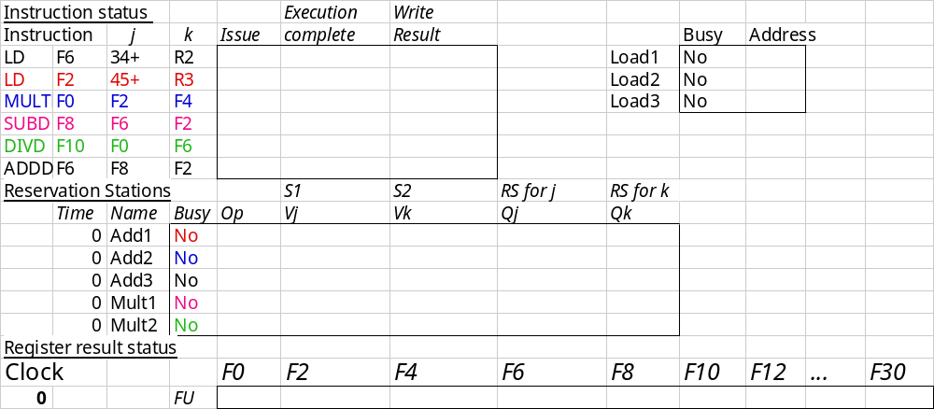
Tomasulo Example Cycle 0

Slide 13
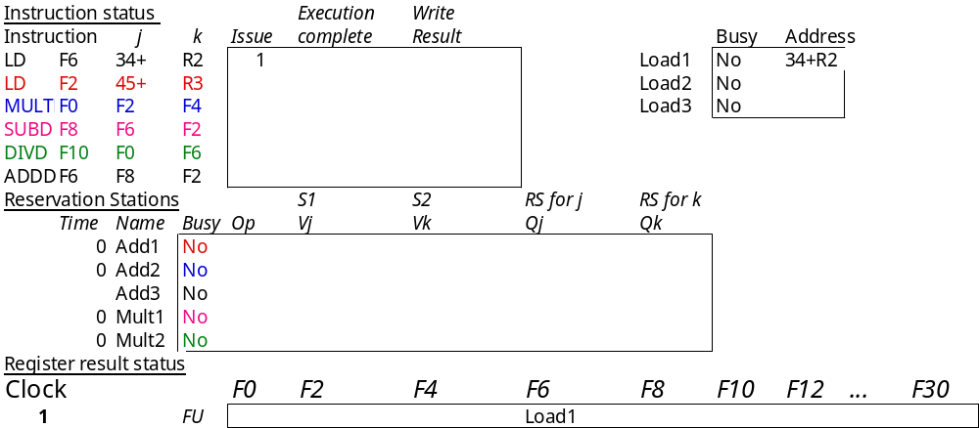
Tomasulo Example Cycle 1
Yes

Slide 14
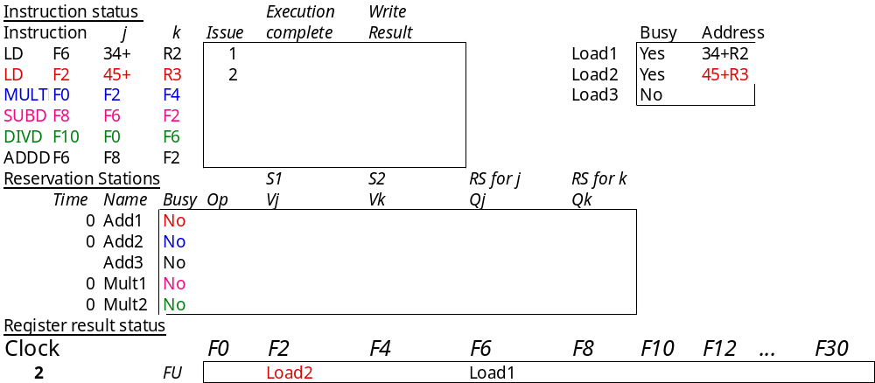
Tomasulo Example Cycle 2
Note: can have multiple loads outstanding

Slide 15
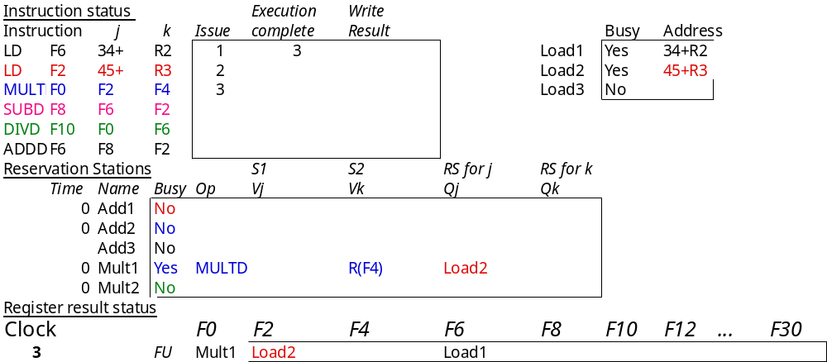
Tomasulo Example Cycle 3
Note: registers names are removed (“renamed”) in Reservation Stations; MULT issued
Load1 completing; what is waiting for Load1?

Slide 16
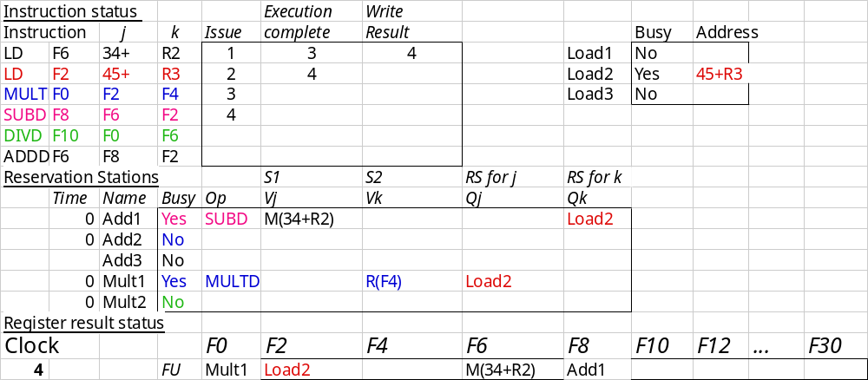
Tomasulo Example Cycle 4
Load2 completing; what is waiting for it?

Slide 17
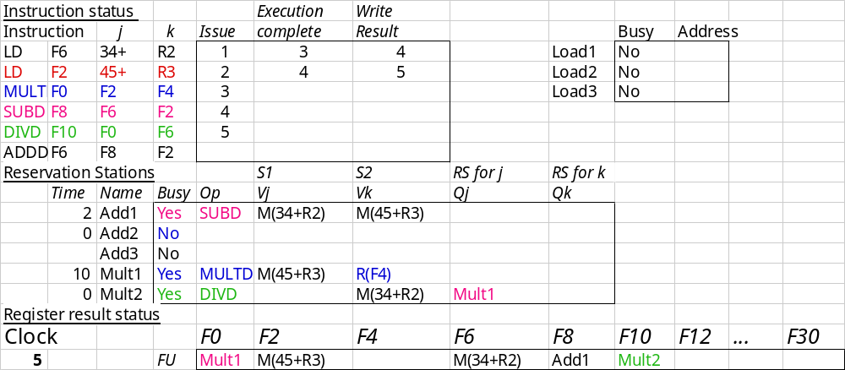
Tomasulo Example Cycle 5

Slide 18
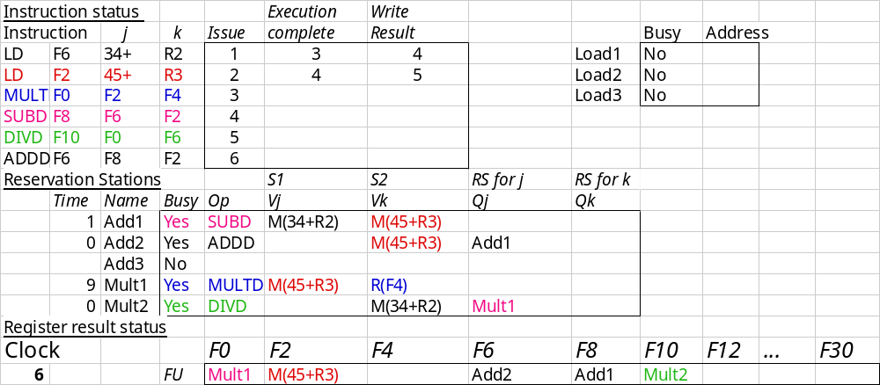
Tomasulo Example Cycle 6
Issue ADDD

Slide 19

Tomasulo Example Cycle 7
Add1 completing; what is waiting for it?

Slide 20
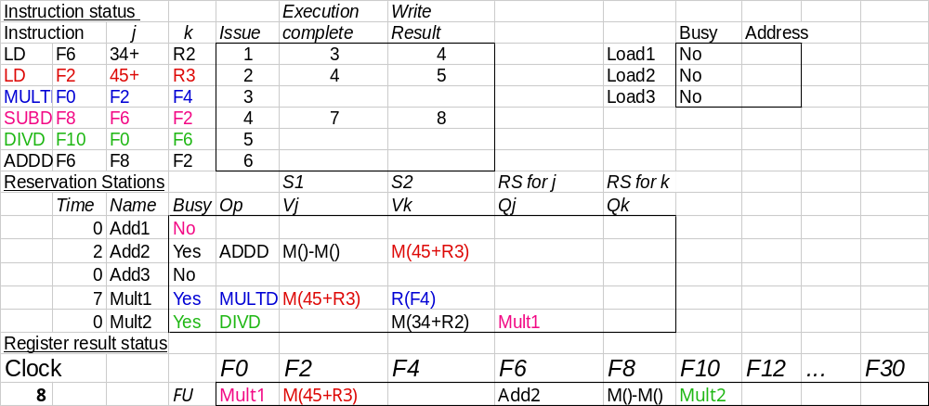
Tomasulo Example Cycle 8

Slide 21
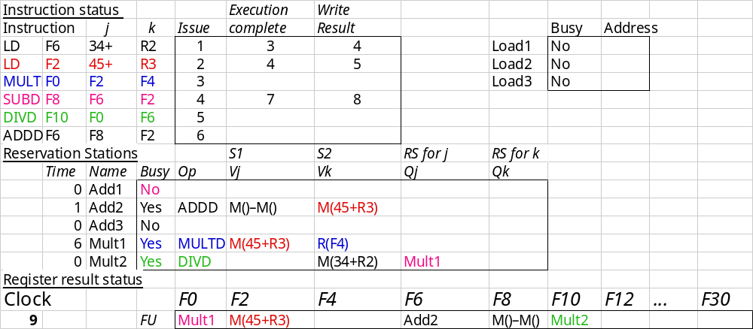
Tomasulo Example Cycle 9

Slide 22
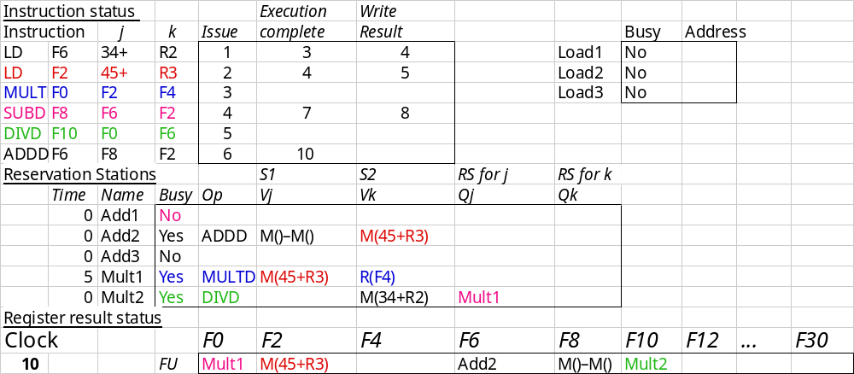
Tomasulo Example Cycle 10
Add2 completing; what is waiting for it?

Slide 23
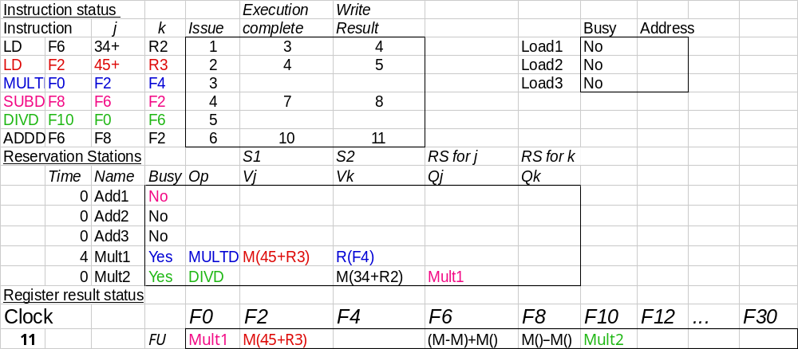
Tomasulo Example Cycle 11
Write result of ADDD here

Slide 24
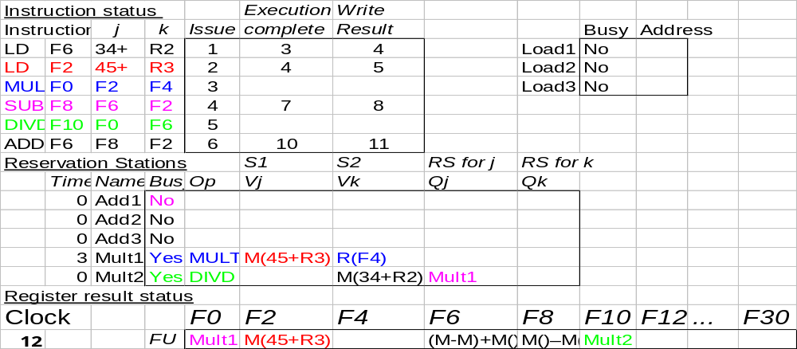
Tomasulo Example Cycle 12
Note: all quick instructions complete already

Slide 25
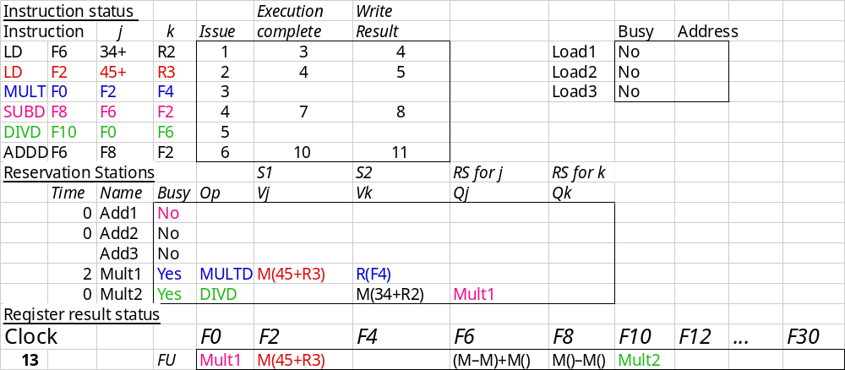
Tomasulo Example Cycle 13

Slide 26

Tomasulo Example Cycle 14

Slide 27
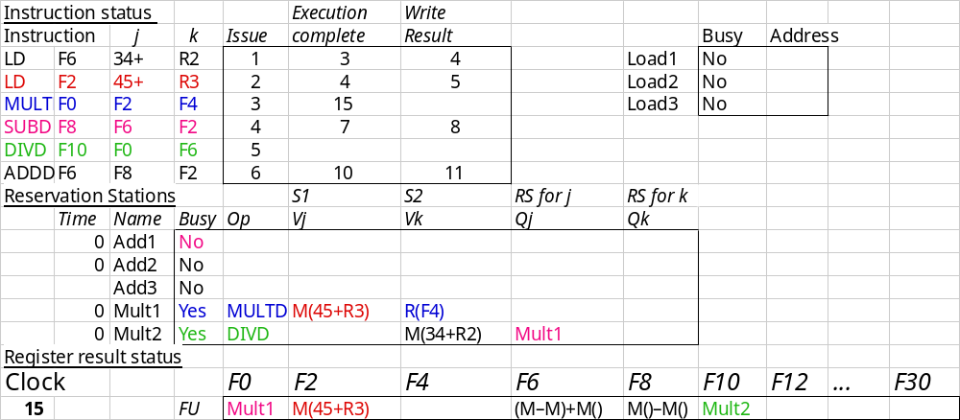
Tomasulo Example Cycle 15
Mult1 completing; what is waiting for it?

Slide 28
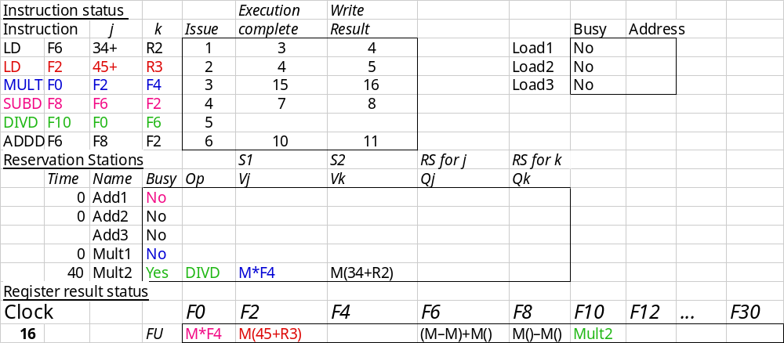
Tomasulo Example Cycle 16
Note: Just waiting for divide

Slide 29
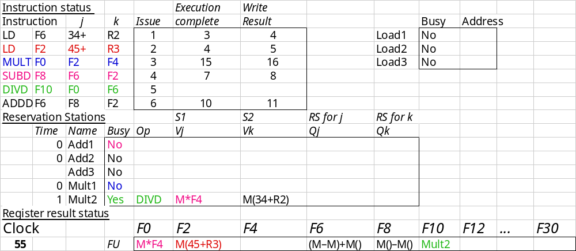
Tomasulo Example Cycle 55

Slide 30
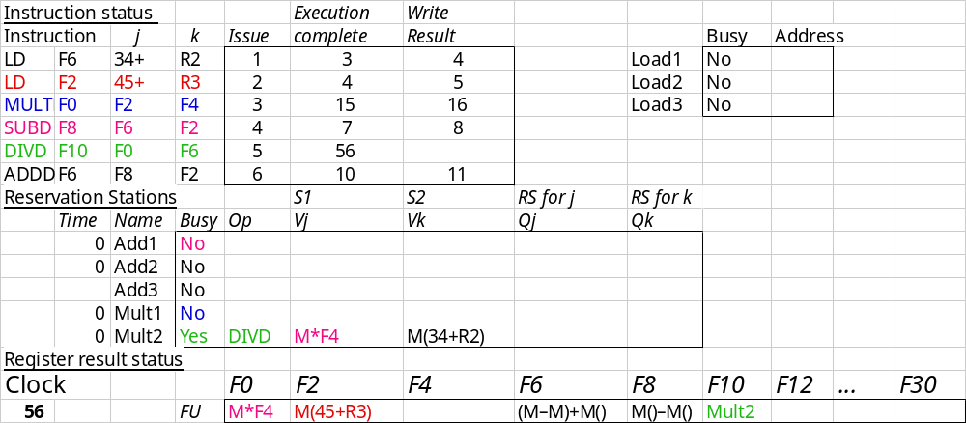
Tomasulo Example Cycle 56
Mult 2 completing; what is waiting for it?

Slide 31
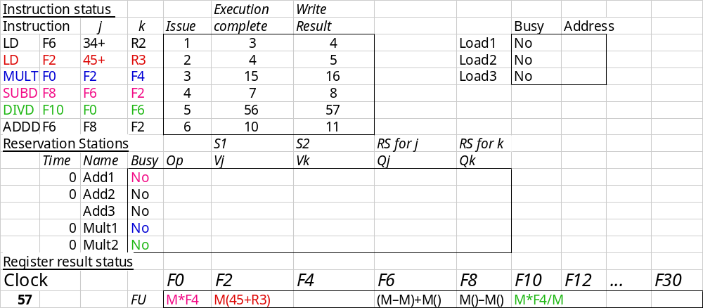
Tomasulo Example Cycle 57
Again, in-oder issue,
out-of-order execution, completion

Slide 32
Tomasulo
Pipelined Functional Units
(6 load, 3 store, 3 +, 2 x/÷)
window size: ≤ 14 instructions
No issue on structural hazard
WAR: renaming avoids
WAW: renaming avoids
Broadcast results from FU
Control: reservation stations

Slide 33
Tomasulo Drawbacks
Complexity
  delays of 360/91, MIPS 10000, IBM 620?
Many associative stores (CDB) at high speed
Performance limited by Common Data Bus
  Multiple CDBs => more FU logic for parallel assoc stores

Slide 34
Tomasulo Loop Example
Loop: LD F0 0 R1
MULTD F4 F0 F2
SD F4 0 R1
SUBI R1 R1 #8
BNEZ R1 Loop
Assume Multiply takes 4 clocks
Assume first load takes 8 clocks (cache miss?), second load takes 4 clocks (hit)

Slide 35
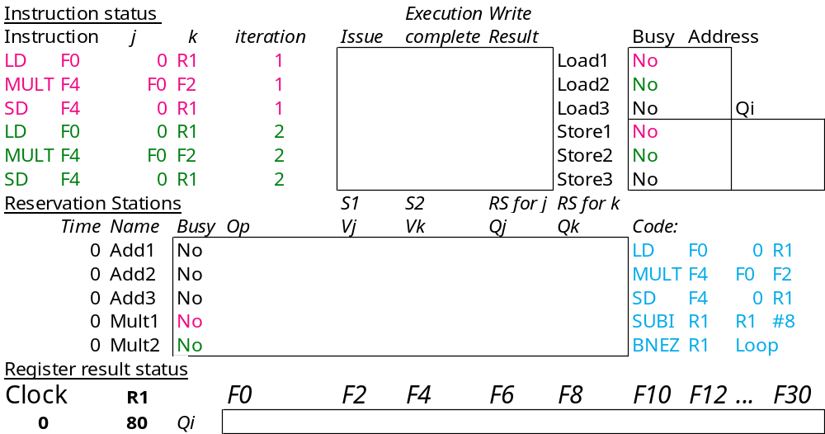
Loop Example Cycle 0

Slide 36
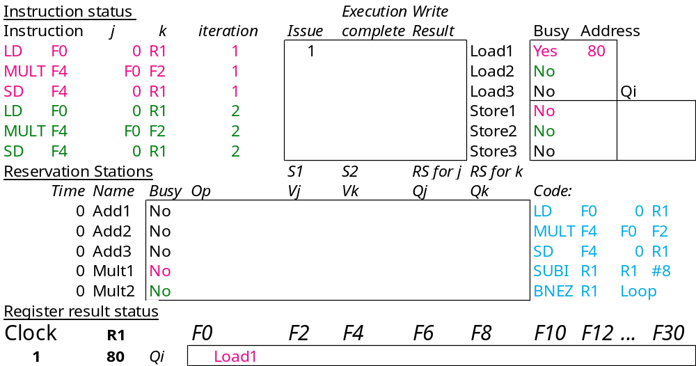
Loop Example Cycle 1

Slide 37
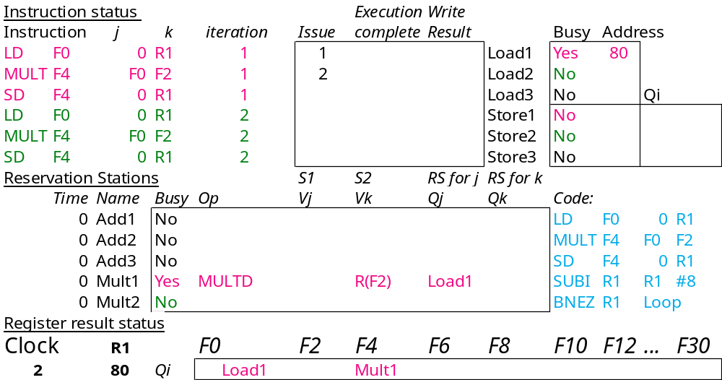
Loop Example Cycle 2

Slide 38
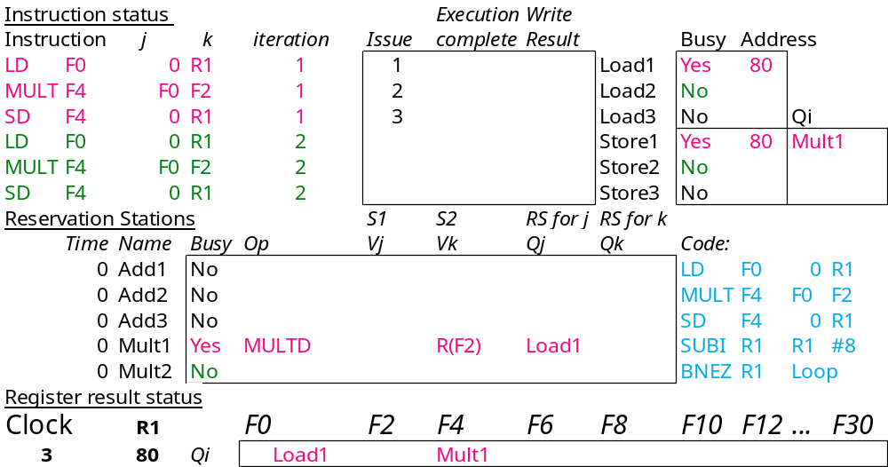
Loop Example Cycle 3
Note: MULT1 has no registers names in RS

Slide 39

Loop Example Cycle 4

Slide 40

Loop Example Cycle 5

Slide 41
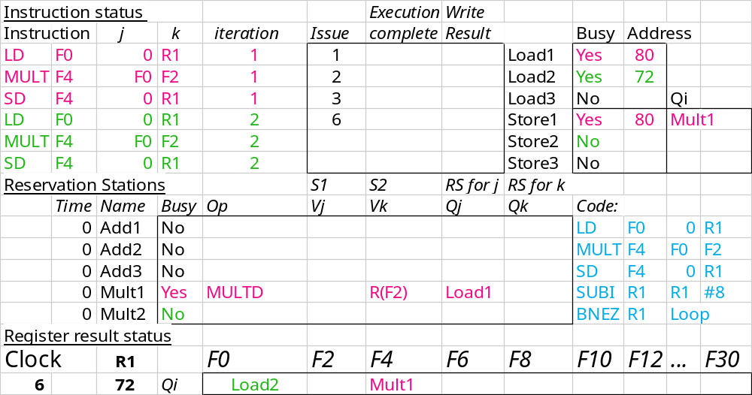
Loop Example Cycle 6
Note: F0 never sees Load1 result

Slide 42
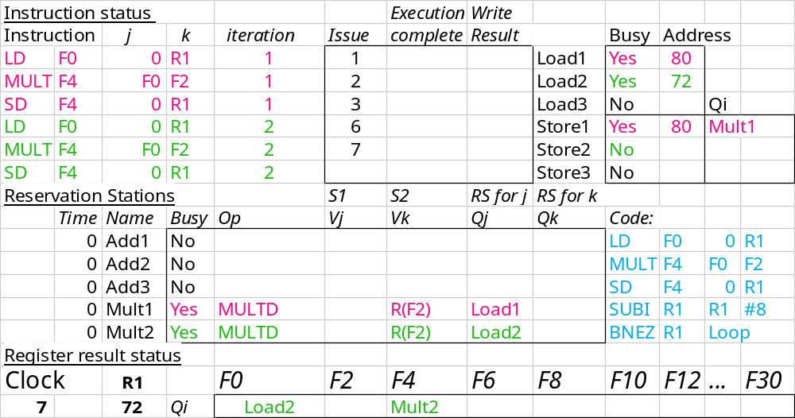
Loop Example Cycle 7
Note: MULT2 has no registers names in RS

Slide 43
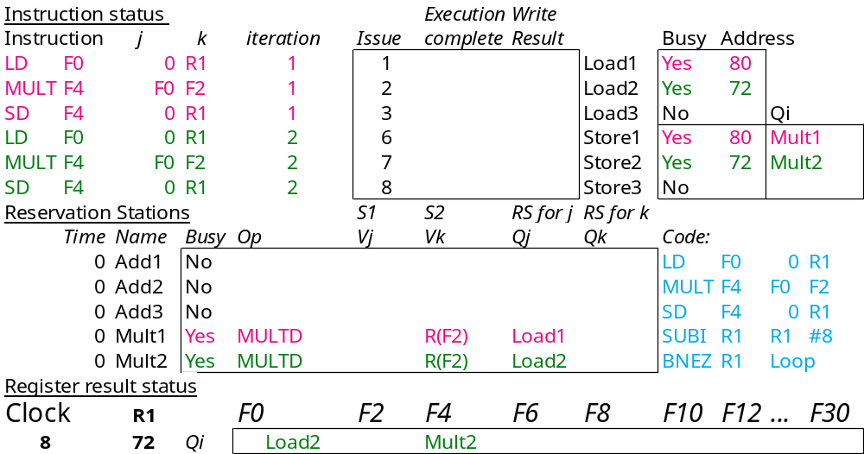
Loop Example Cycle 8

Slide 44
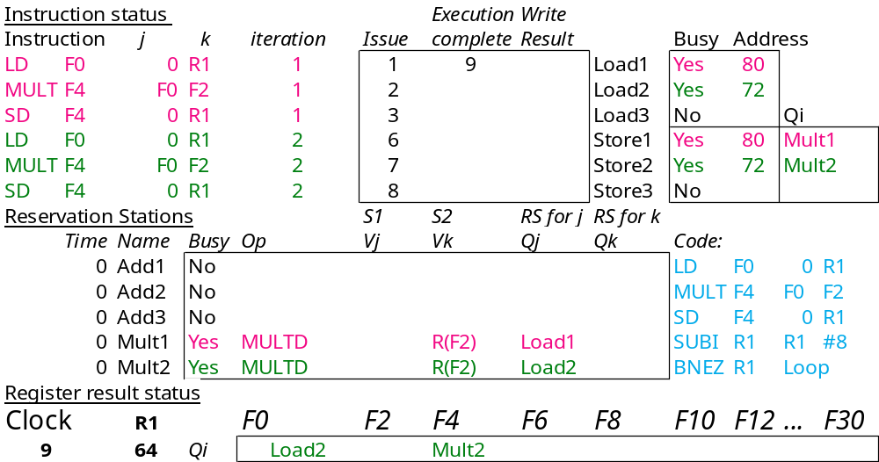
Loop Example Cycle 9
Load1 completing; what is waiting for it?

Slide 45
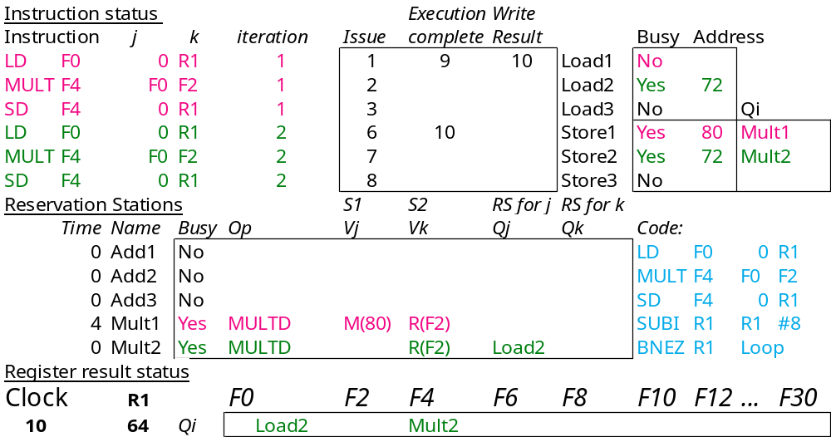
Loop Example Cycle 10
Load2 completing; what is waiting for it?

Slide 46
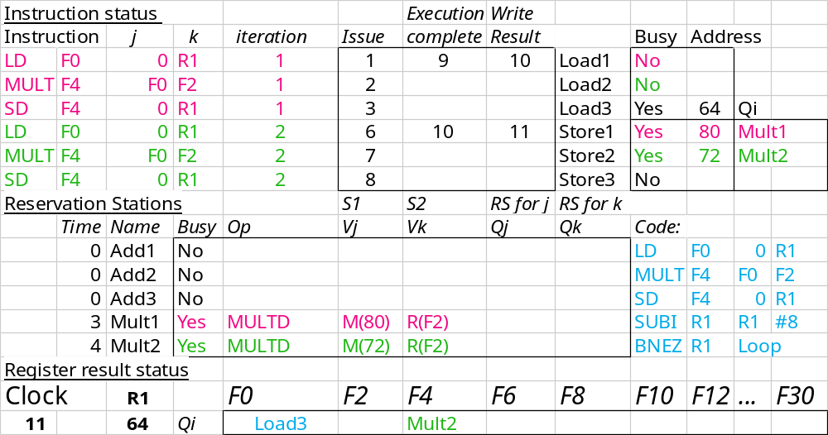
Loop Example Cycle 11

Slide 47

Loop Example Cycle 12

Slide 48

Loop Example Cycle 13

Slide 49
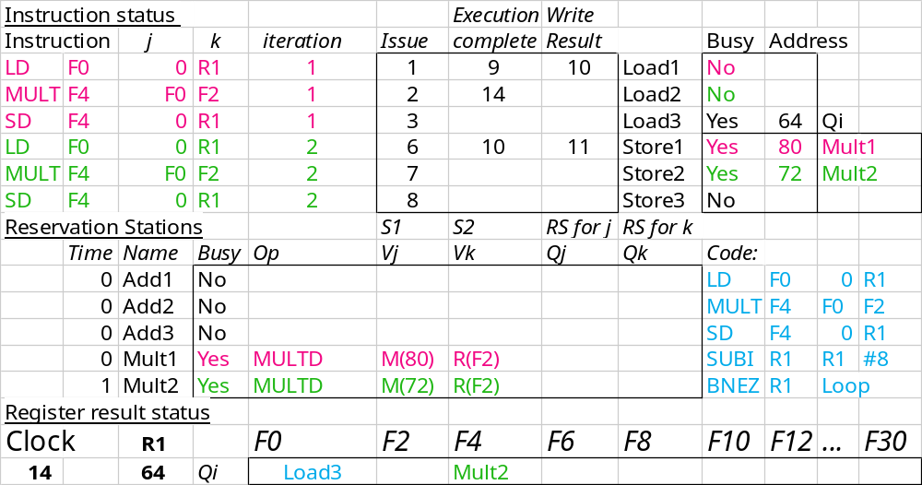
Loop Example Cycle 14
Mult1 completing; what is waiting for it?

Slide 50
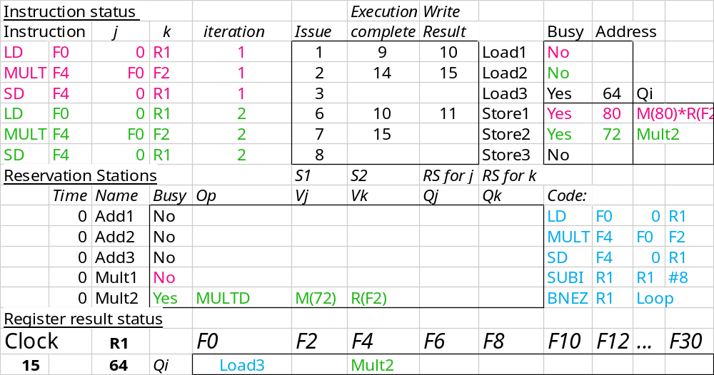
Loop Example Cycle 15
Mult2 completing; what is waiting for it?

Slide 51
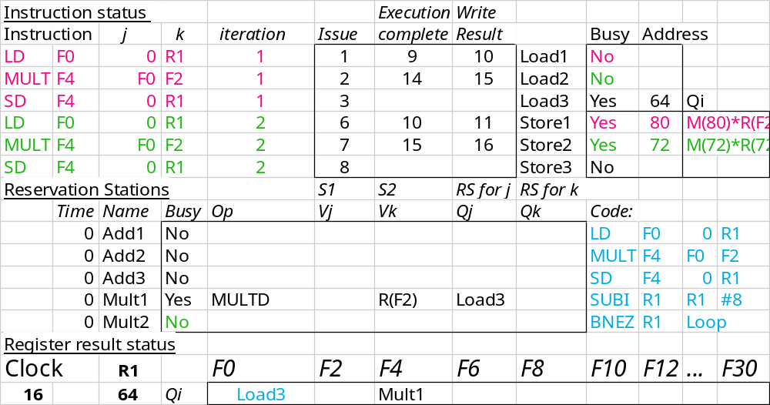
Loop Example Cycle 16

Slide 52
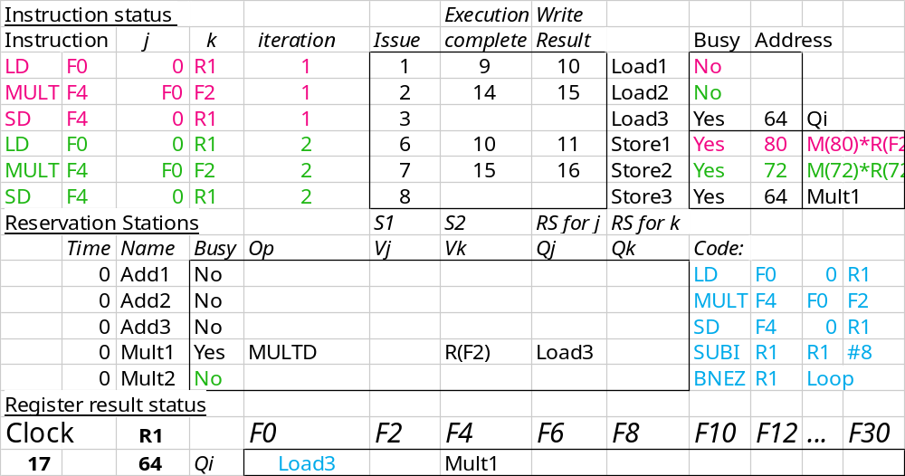
Loop Example Cycle 17

Slide 53

Loop Example Cycle 18

Slide 54
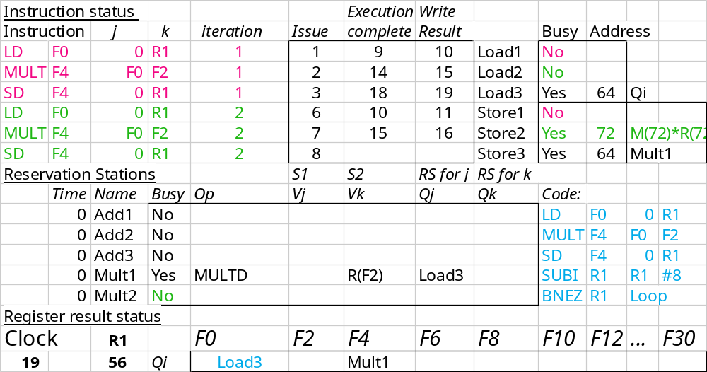
Loop Example Cycle 19

Slide 55

Loop Example Cycle 20

Slide 56
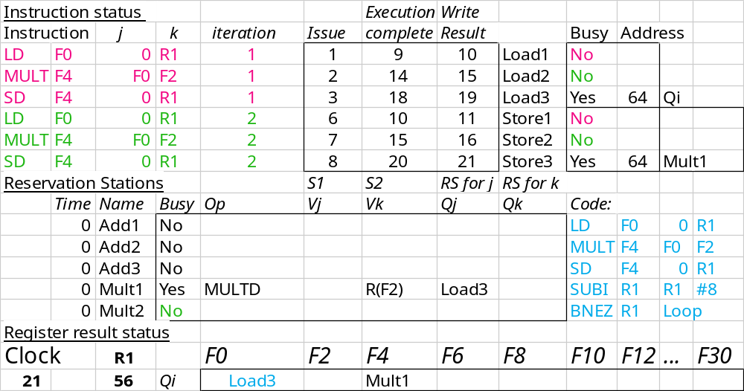
Loop Example Cycle 21

